Slide 1
Singapore Travel Guide
Code Monkey Team

Slide 2
OUTLINE
Motivation
Objective
Implementation
Marketing&Competitiors Analysis
Team Work

Slide 3
MOTIVATION
Importance
Monitor the level of traffic congestion very accurately
Easy to use
Powerful

Slide 4
MOTIVATION
How to help users?
Users can plan their travel times and routes by using our product to monitor traffic congestion levels in real time.

Slide 5
OBJECTIVE
Aim: A Travel Guide for Singapore
Tell the user whether the traffic is crowded
display real time traffic status
Application of the ML model
Recommend one or more optimal path if multiple routes are available depending on time or shortest path

Slide 6
OBJECTIVE
Aim: A Travel Guide for Singapore
Memorize routes
save the start/end point information the first time it is inputed
set the most viewed as preference
(optional) Add some features about recommending where to go

Slide 7
INPLEMENT
Data collection:
Get the API available on data.gov.sg for displaying live traffic pictures around Singapore.
Write code to fetch traffic picture data from the API and save it in a storage service in the AWS cloud

Slide 8
INPLEMENT
Image processing and vehicle counting:
A machine learning model such as Amazon Rekognition, can be used for image processing and vehicle counting functions.
Store the vehicle count results in a database, such as Amazon RDB, for analysis and decision making.

Slide 9
INPLEMENT
Route planning and user preferences:
Implement a user interface (which can be a web page or a mobile app) that allows the user to enter the start and end point of a commuter route.
After the user enters the commute route for the first time, save that information as the user's preference for the next time.

Slide 10
INPLEMENT
Traffic congestion judgment and displays the traffic status
Design a threshold for determining whether traffic is currently congested
Draw paths on the map.
Displays the traffic status in the user interface and give suggestions

Slide 11
MARKEY ANALYSIS
Market Size
Traffic congestion is a common problem in urban life, so there is a high degree of attention to traffic conditions. According to the Global Transportation market, the traffic management and navigation applications market is worth more than $10 billion

Slide 12
MARKEY ANALYSIS
Difference
Google Maps : historical data about the average time it takes to travel a particular section of road at specific times on specific days and real-time data sent by sensors and smartphones
Ours : analyze junction vehicle data to obtain real-time road conditions.

Slide 13
COMPETITORS ANALYSIS
Real-time
In countries with developed tourism, high real-time performance can better meet the needs of tourists
Accuracy
We process information with real-time images more accurately than other apps

Slide 14
TEAM WORK
Front End---Tang Tang
AI---Yao ChenXuan
Database---Zhu YunDian
Processing---Liu ChengHang

Slide 15
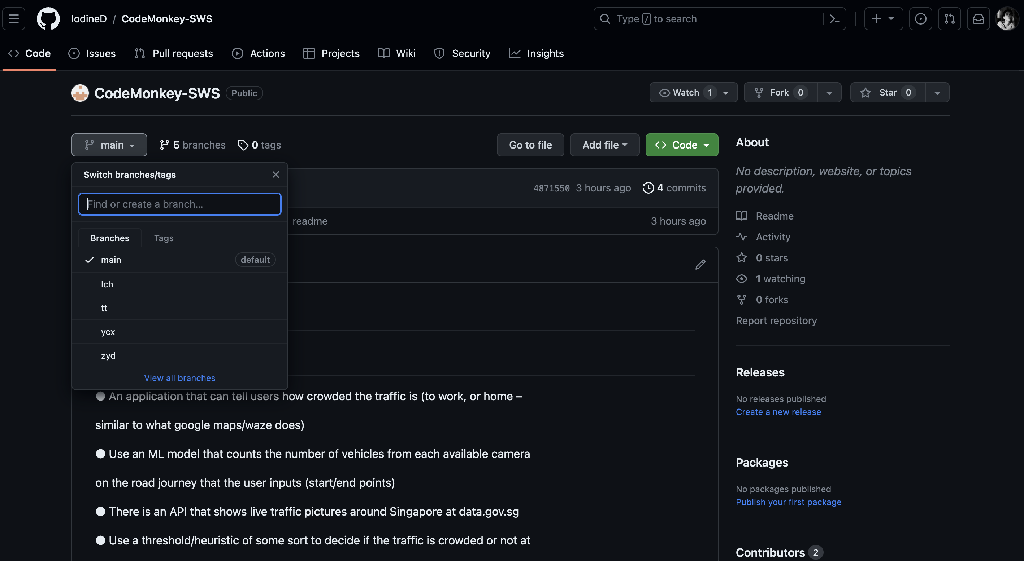
Singapore Travel Guide
Code Monkey Team

